Slide 1
Spark Streaming

Slide 2
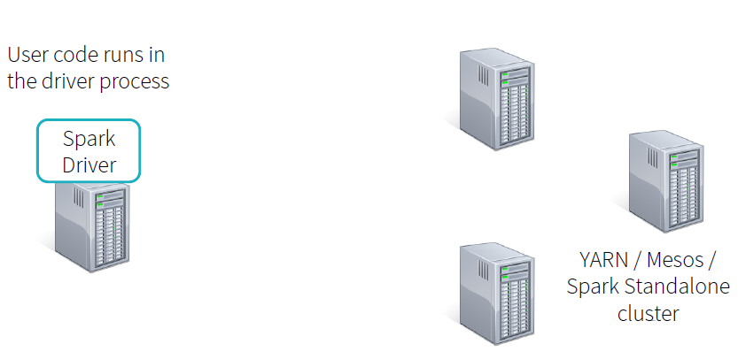
Spark Application step 0

Slide 3
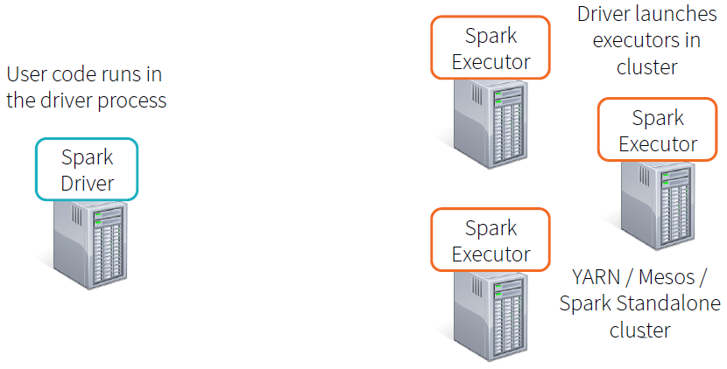
Spark Application step 1

Slide 4
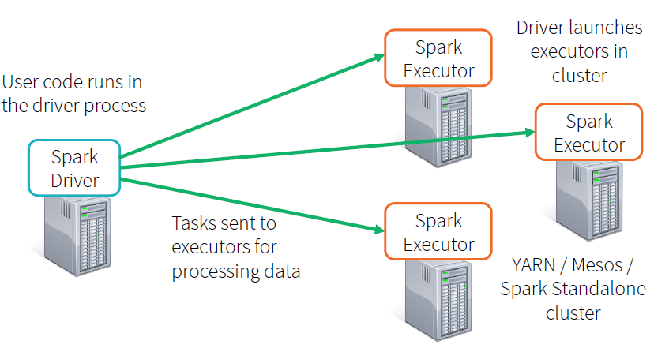
Spark Application step 2

Slide 5
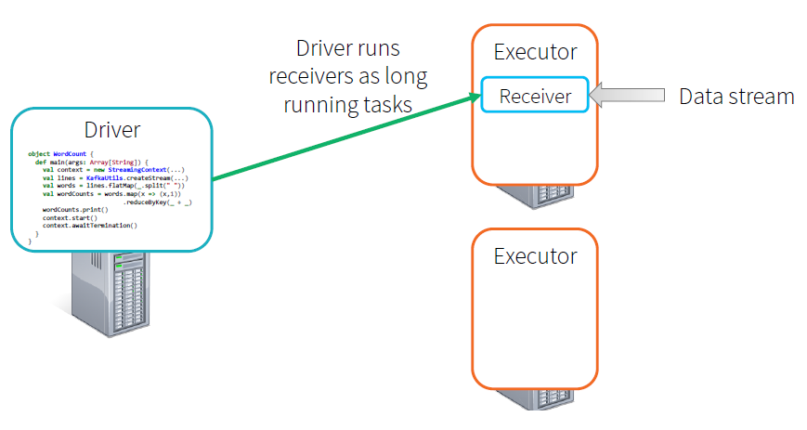
Streaming Step 1

Slide 6
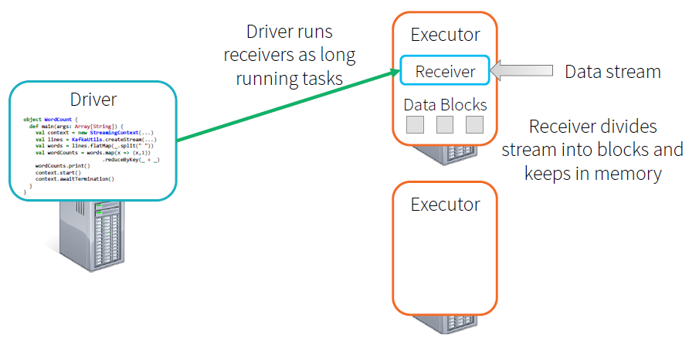
Streaming Step 2

Slide 7
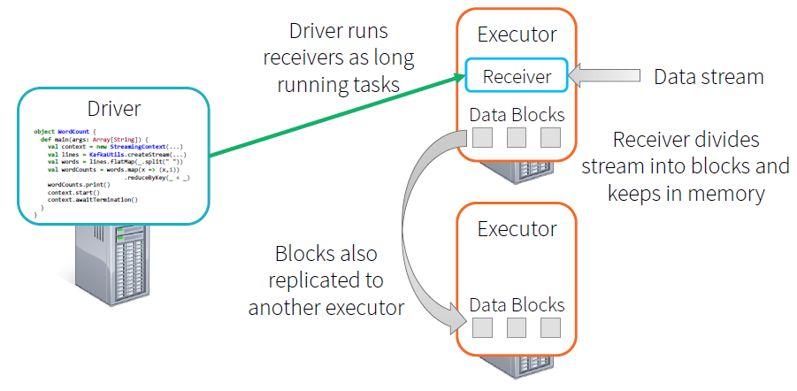
Streaming Step 3

Slide 8
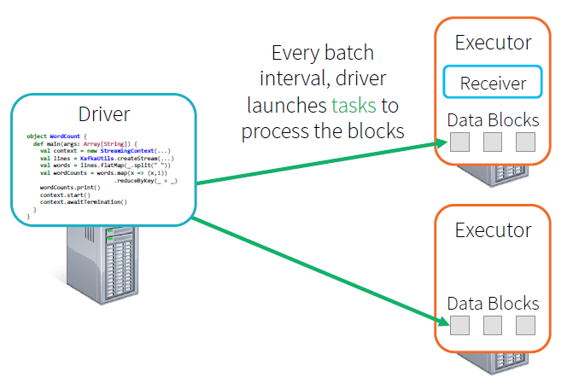
Streaming Step 4

Slide 9
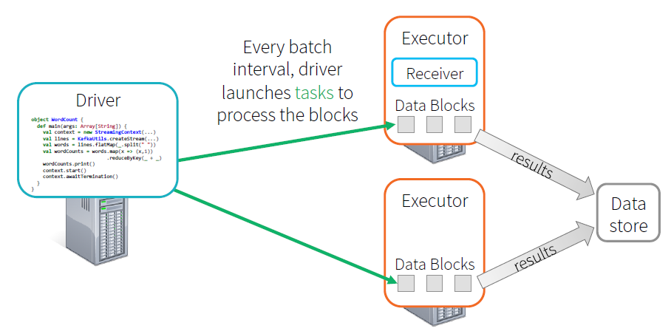
Streaming Step 5

Slide 10
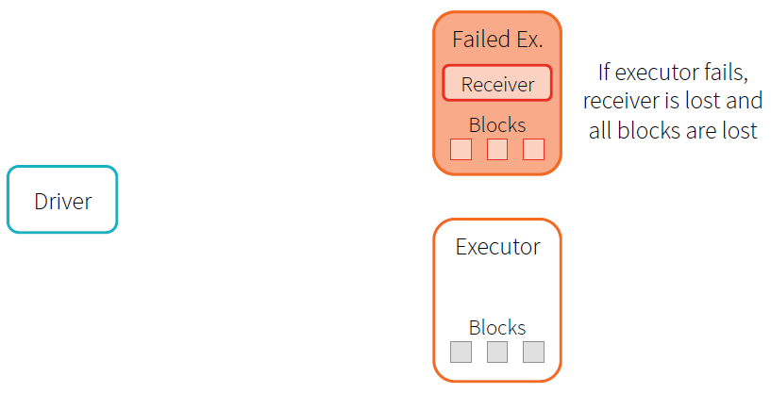
What if an executor fails?

Slide 11
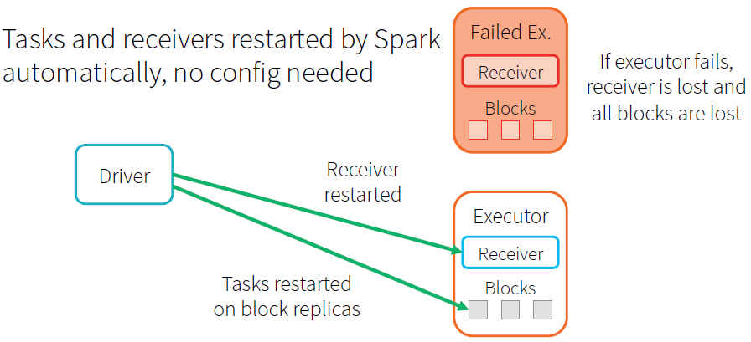
Automatic Recovery

Slide 12
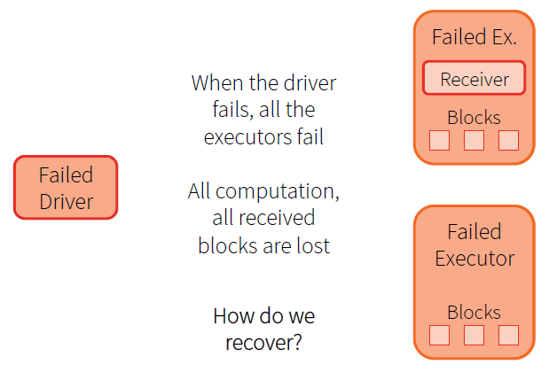
What if the driver fails?

Slide 13
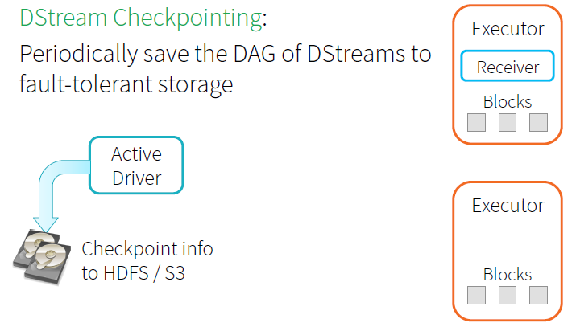
Recovering Driver w/ DStream Checkpointing

Slide 14
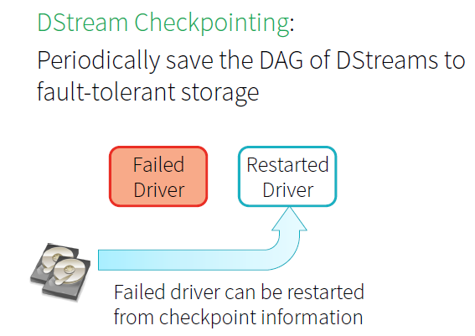
Recovering Driver w/ DStream Checkpointing

Slide 15
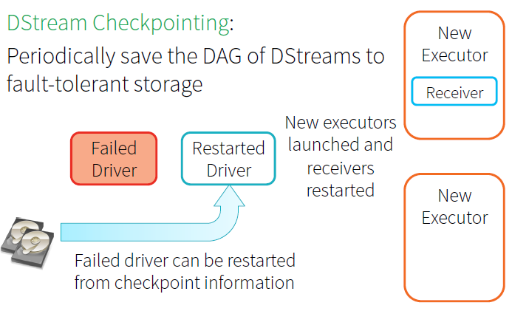
Recovering Driver w/ DStream Checkpointing

Slide 16
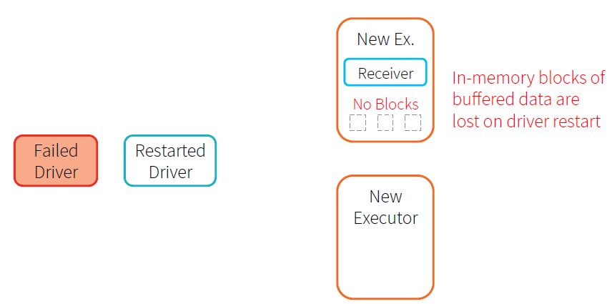
Received blocks lost on Restart!

Slide 17
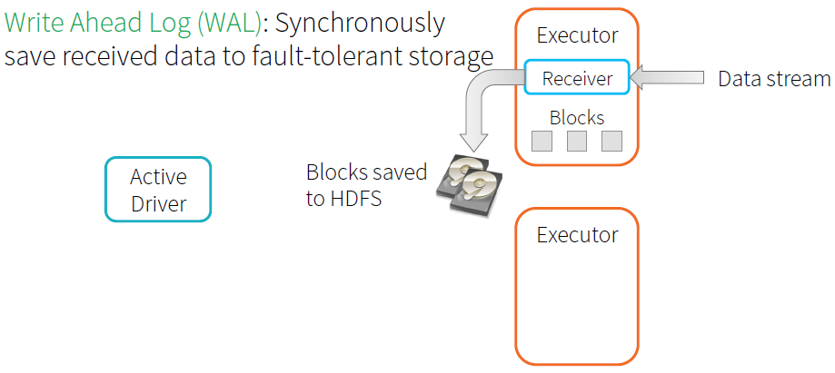
Recovering data with Write Ahead Logs

Slide 18
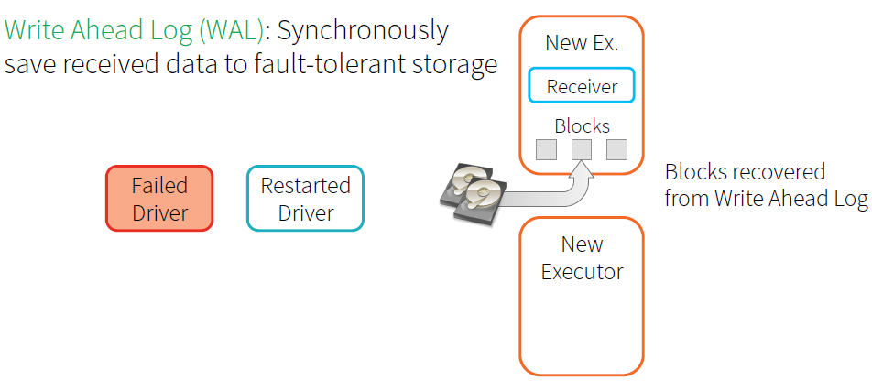
Recovering data with Write Ahead Logs

Slide 19
Zero data loss = every stage processes each event at least once despite any failure

